Slide 1

6th Grade Math
Unit 2, Lesson 9 Fluency with Operations Volume 1, pg. 86

Slide 2


Benchmarks
MA.6.NSO.2.1
Multiply and divide positive multi-digit numbers with decimals to the thousandths, including using a standard algorithm with procedural fluency.
MA.6.NSO.2.2
Multiply and divide positive multi-digit numbers with decimals to the thousandths, including using a standard algorithm with procedural fluency.
volume 1, pg. 86

Slide 3
Integrated Mathematical Thinking and Reasoning Standard
MA.K12.MTR.3.1 Complete tasks with mathematical fluency.
volume 1, pg. 86

Slide 4

Learning Targets
I can fluently multiply and divide multi-digit numbers with decimals to the thousandths.
I can fluently multiply and divide positive fractions by positive fractions.
volume 1, pg. 86

Slide 5

Warm-Up
volume 1, pg. 87

Slide 6
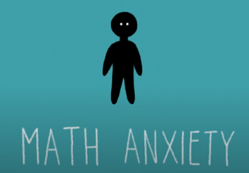
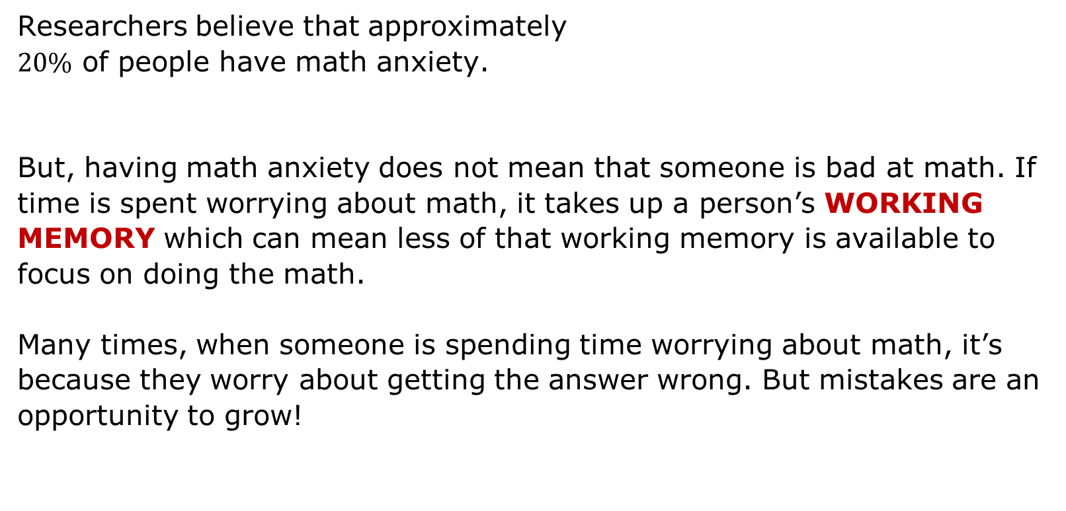
2.9.1 Warm-Up: Math Anxiety
Researchers believe that approximately
$20\%$ of people have math anxiety.
But, having math anxiety does not mean that someone is bad at math. If time is spent worrying about math, it takes up a person’s WORKING MEMORY which can mean less of that working memory is available to focus on doing the math.
Many times, when someone is spending time worrying about math, it’s because they worry about getting the answer wrong. But mistakes are an opportunity to grow!
volume 1, pg. 87

Slide 7
What is a mistake you made in math that worked as a learning opportunity?
It’s also helpful to remember that your brain grows and improves each time you learn something new. This is called having a GROWTH MINDSET and can help improve your confidence in math when you realize that everyone can be successful in math – including you!
Describe a time when you weren’t very confident on something, but after practicing you became successful.
volume 1, pg. 87

Slide 8

Guided Practice
volume 1, pg. 87

Slide 9

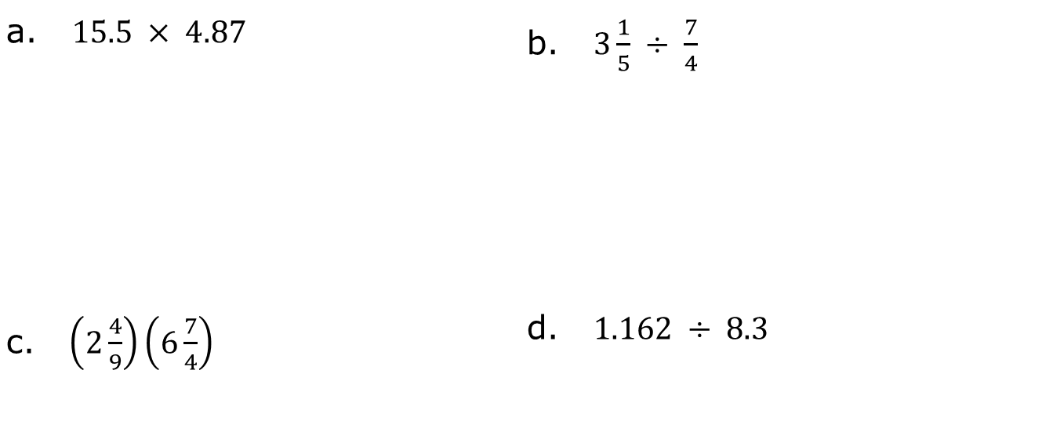
2.9.2 Guided Practice: Fluency with Operations
Work with your partner to find each product or quotient. Share strategies and discuss any questions you still have about how to perform each operation.
a. $15.5 × 4.87$ | b. $3\frac{1}{5} ÷ \frac{7}{4}$
c. $\left(2\frac{4}{9}\right)\left(6\frac{7}{4}\right)$ | d. $1.162 ÷ 8.3$
volume 1, pg. 87

Slide 10

Activity
volume 1, pg. 88

Slide 11

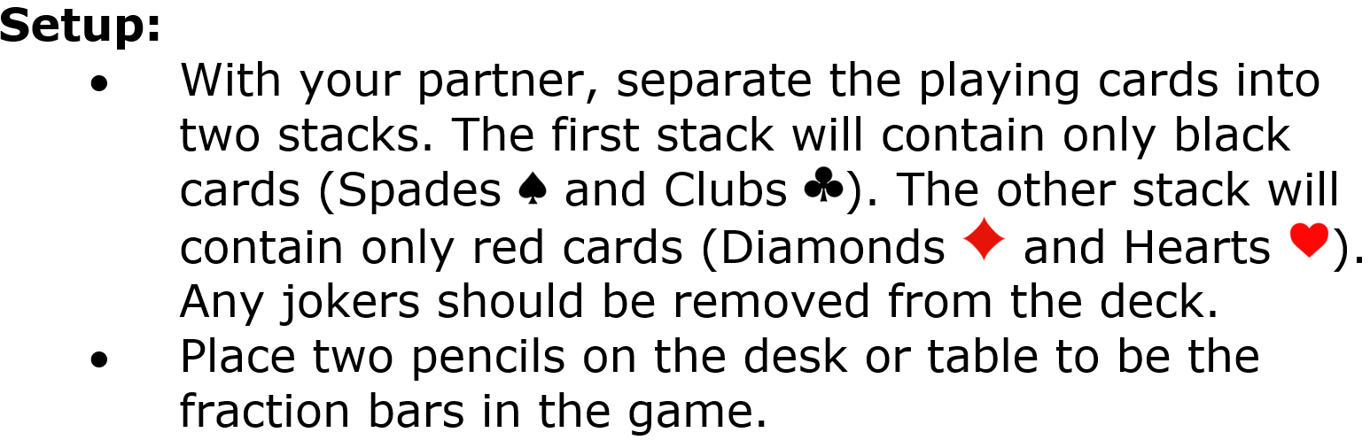
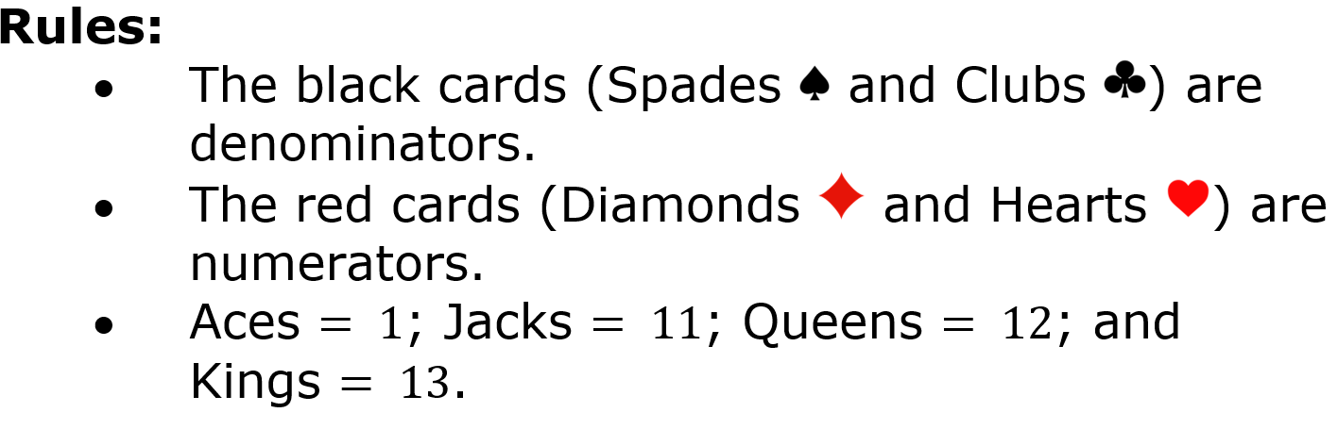
2.9.3 Activity: Fraction War
volume 1, pg. 88

Slide 12
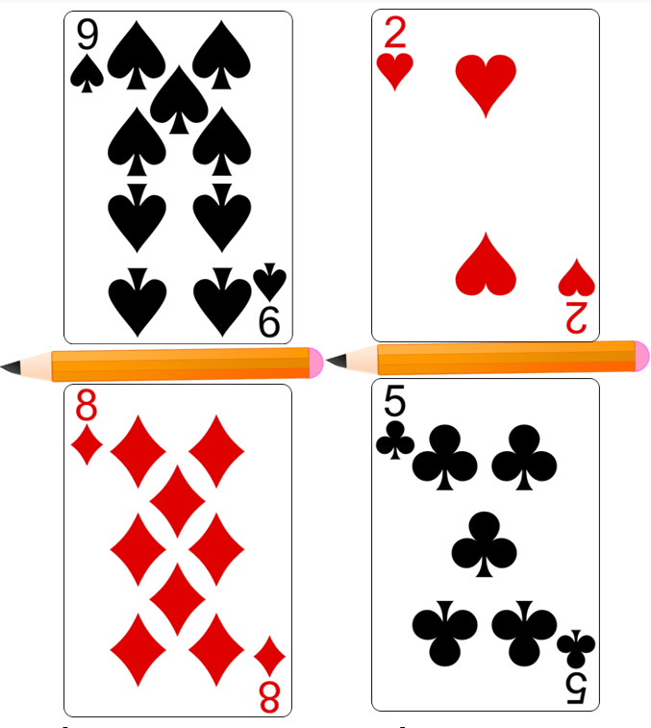
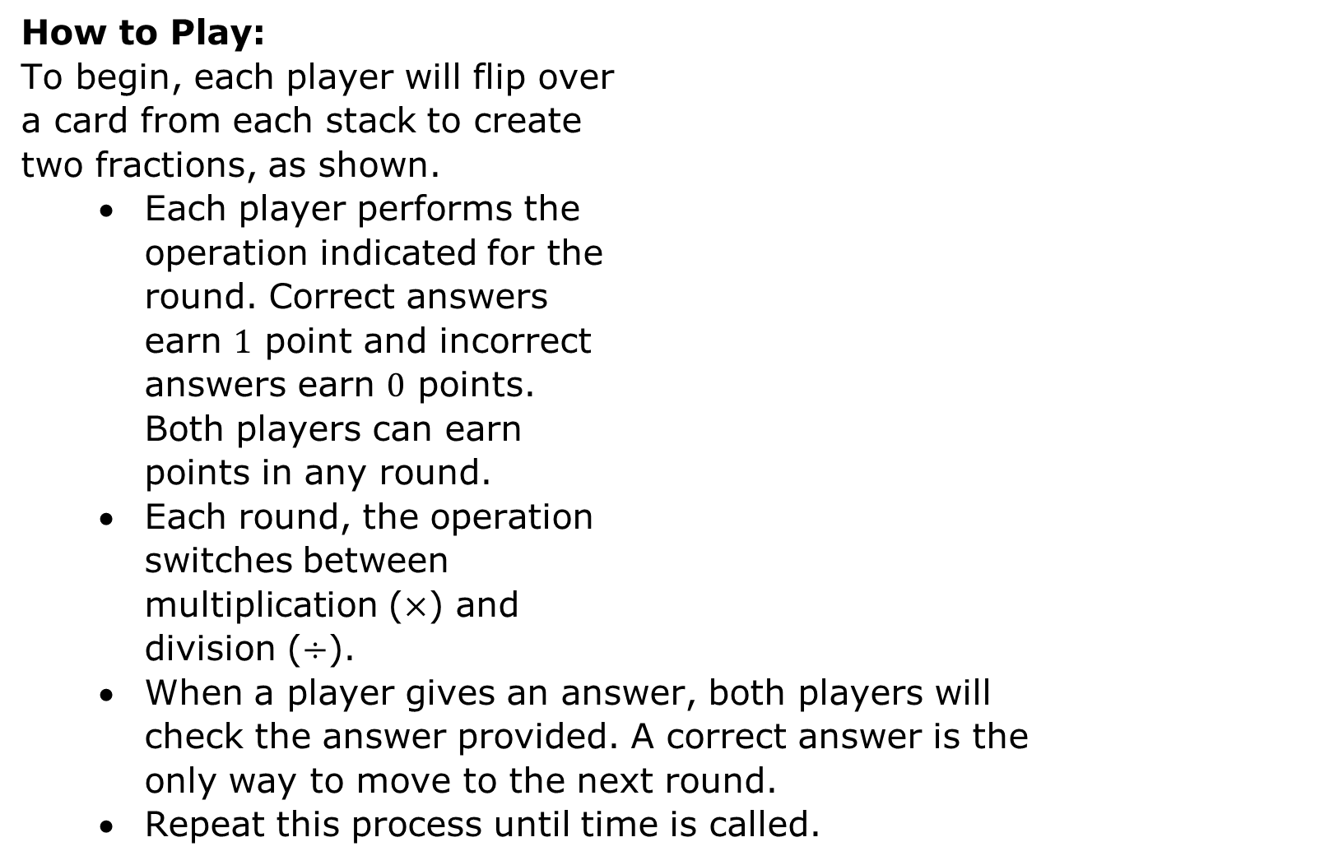
How to Play:
To begin, each player will flip over
a card from each stack to create
two fractions, as shown.
Each player performs the
operation indicated for the
round. Correct answers
earn $1$ point and incorrect
answers earn $0$ points.
Both players can earn
points in any round.
Each round, the operation
switches between
multiplication ($×$) and
division ($÷$).
When a player gives an answer, both players will
check the answer provided. A correct answer is the
only way to move to the next round.
Repeat this process until time is called.
volume 1, pg. 88

Slide 13
Scoreboard |  | Workspace
Player A: _______ | Player B: _______
volume 1, pg. 88

Slide 14

Your Turn
volume 1, pg. 89

Slide 15
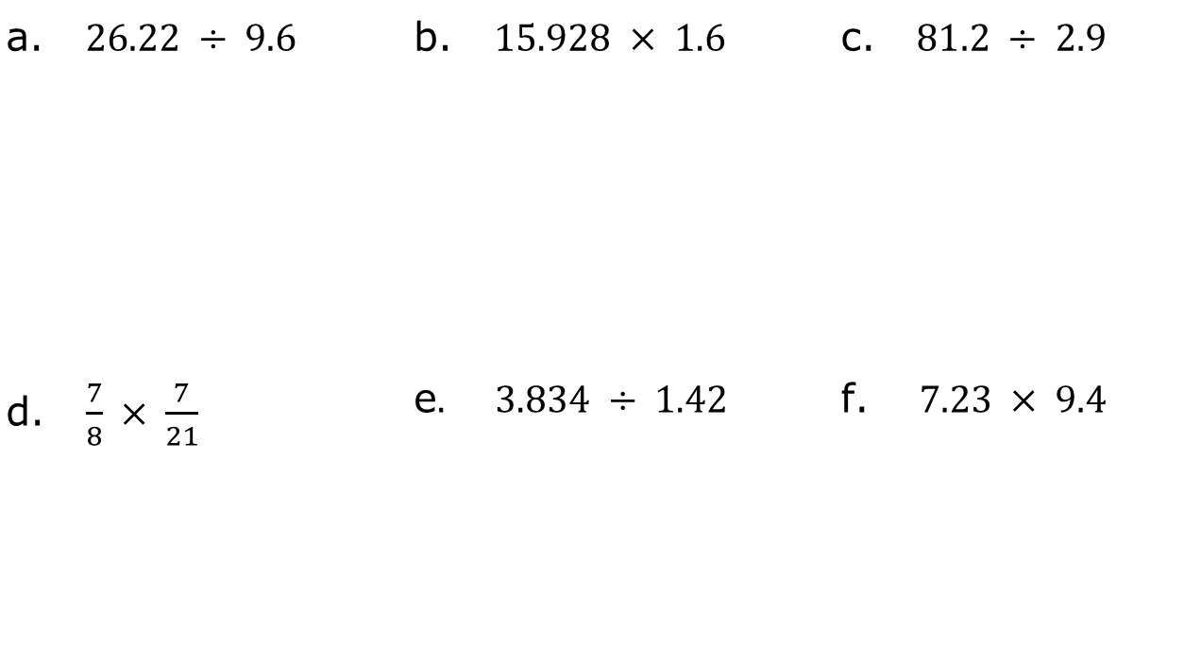
2.9.4 Your Turn!
Find each product or quotient. Show your work.
a. $26.22 ÷ 9.6$ | b. $15.928 × 1.6$ | c. $81.2 ÷ 2.9$
d. $\frac{7}{8} × \frac{7}{21}$ | e$. 3.834 ÷ 1.42$ | f. $7.23 × 9.4$
volume 1, pg. 89

Slide 16
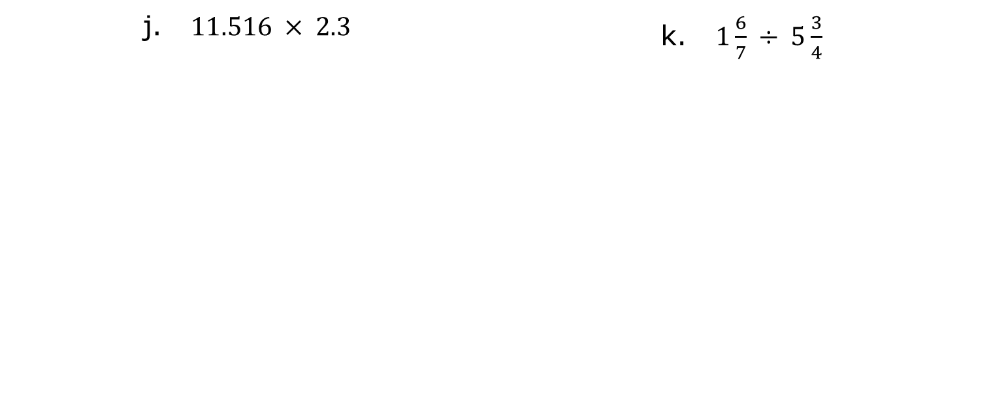
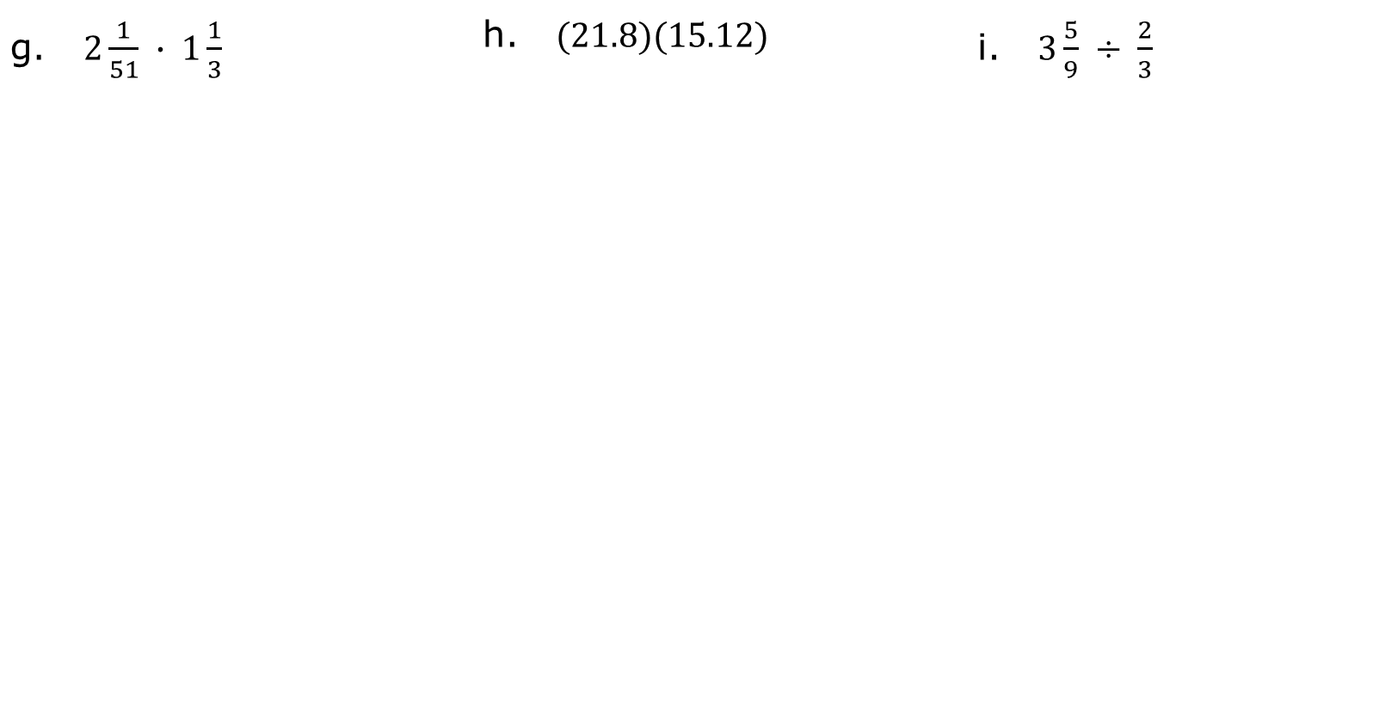
g. $2\frac{1}{51} ∙ 1\frac{1}{3}$ | h. $(21.8)(15.12)$ | i. $3\frac{5}{9} ÷ \frac{2}{3}$
j. $11.516 × 2.3$ | k. $1\frac{6}{7} ÷ 5\frac{3}{4}$
volume 1, pg. 89

Slide 17

Wrap-Up
volume 1, pg. 90

Slide 18
2.9.5 Wrap-Up: Reflection
Color in the arrow up to the statement that best describes your current level of confidence with multiplying and dividing fractions and decimals.
I’m very confident! I can perform each operation and I could explain this to someone else.
I can get to the right answer when performing each operation, but I don’t understand well enough to explain it yet.
I understand some of this, but I don’t understand all of it yet. Check off what you do understand.
Multiplying decimals
Dividing decimals
Multiplying fractions
Dividing fractions
I have been trying hard and listening, but I am
finding this challenging. I will get help by _____
_______________________________________.
I do not understand any of this yet. I will get
help by _________________________________
_______________________________________.
volume 1, pg. 90

